Slide 1
Using Zero Shot Classification on Financial News Headlines
Dylan Viswambaran

Slide 2
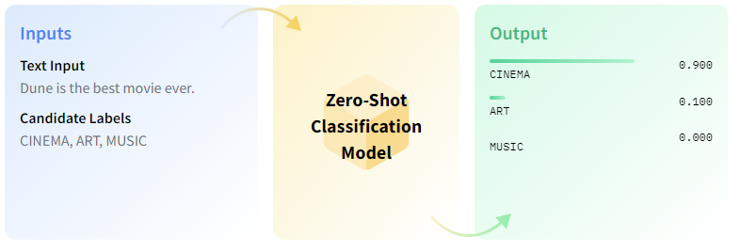
Overview
What is Zero Shot Classification?
Zero-shot text classification is a task in natural language processing where a model is trained on a set of labelled examples but is then able to classify new examples from previously unseen classes.
Notes:
As shown in the example above – there are two inputs into the model – Text Inputs and Candidate Labels – Both of which are provided by the user. This is fed into the zero shot classification model and it will then classify the text input into the labels provided. In this case you can see the output on the right where Cinema was given a 90% probability of being the label that represents the text input.

Slide 3
Why use Zero Shot Learning?
Adaptability to new classes
Ability to classify data into categories that were not present during the training phase (of the initial model)
Cost Efficiency
Data Efficiency
Notes:
One of the most significant advantages of zero-shot classification is its ability to classify data into categories that were not present during the training phase. This adaptability is crucial in dynamic domains where new classes can emerge over time.
Cost efficient - Continuously collecting and annotating data for new classes can be expensive and time-consuming. Zero-shot classification can reduce the need for such efforts, making it more cost-effective in the long run.
Data efficiency - In situations where there's limited labeled data available for certain classes, zero-shot classification can still perform effectively, making the most of the available information.

Slide 4
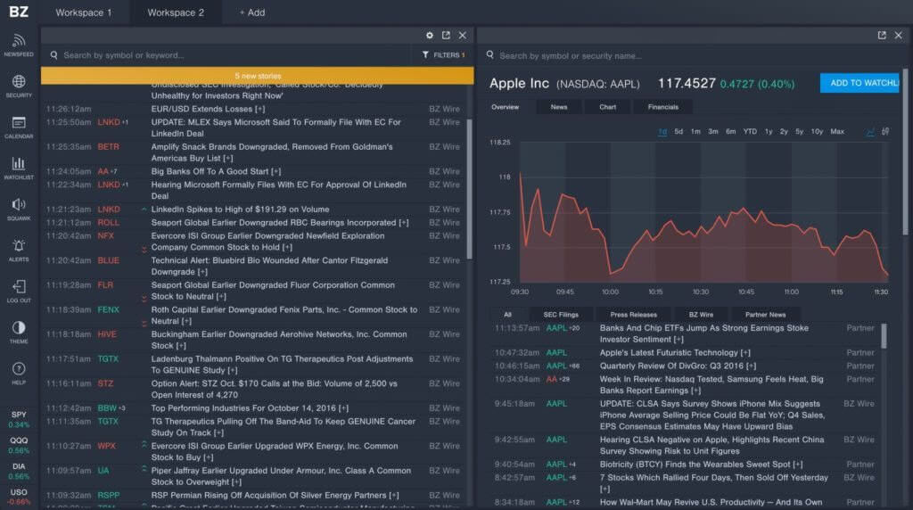
How can this be applied to Financial Data within the organisation?
The Prudential Regulation Authority is responsible for the safety and soundness of the firms it regulates, focusing on the adverse effects that they can have on the stability of the UK financial system.
One way to monitor firms is via real time news feeds – this can provide crucial information on events affecting firms which may be of interest to supervisors when considering any potential supervisory intervention.
Using a zero shot model would provide a reliable method of sifting through millions of news articles to identify those of particular interest.
Notes:
Given the ZSL model is capable of classifying text without being trained on it makes it highly accessible for us here to quickly label article headlines into appropriate risk categories – namely Credit, liquidity, markets, operational and generic risk – amongst other terms of interest such as fines frauds etc.

Slide 5

Implications
Bulleted subtitle (Arial 24pt)
Bulleted body text (Arial 20pt)
Bulleted source (Arial 16pt)

Slide 6

Bulleted subtitle (Arial 24pt)
Bulleted body text (Arial 20pt)
Bulleted source (Arial 16pt)
Subtitle (Arial 24pt)
Body text (Arial 20pt)
Source (Arial 16pt)

Slide 8


Slide 9
Bulleted subtitle (Arial 24pt)
Subtitle (Arial 20pt)
Bulleted slide body text (Arial 16pt)
Body text (Arial 24pt)
Bulleted source (Arial 20pt)
Source (Arial 16pt)
Bulleted subtitle (Arial 24pt)
Subtitle (Arial 20pt)
Bulleted slide body text (Arial 16pt)
Body text (Arial 24pt)
Bulleted source (Arial 20pt)
Source (Arial 16pt)

Slide 10
Bulleted subtitle (Arial 24pt)
Bulleted body text (Arial 20pt)
Bulleted subtitle (Arial 24pt)
Bulleted body text (Arial 20pt)
Bulleted subtitle (Arial 24pt)
Bulleted body text (Arial 20pt)
Bulleted subtitle (Arial 24pt)
Bulleted body text (Arial 20pt)

Slide 11

Bulleted subtitle (Arial 24pt)
Subtitle (Arial 20pt)
Bulleted slide body text (Arial 16pt)
Body text (Arial 24pt)
Bulleted source (Arial 20pt)
Source (Arial 16pt)
Bulleted subtitle (Arial 24pt)
Subtitle (Arial 20pt)
Bulleted slide body text (Arial 16pt)
Body text (Arial 24pt)
Bulleted source (Arial 20pt)
Source (Arial 16pt)

Slide 12
Subtitle (Arial 24pt)
Body text (Arial 20pt)
Source (Arial 16pt)
Bulleted subtitle (Arial 24pt)
Bulleted body text (Arial 20pt)
Bulleted source (Arial 16pt)
Subtitle (Arial 24pt)
Body text (Arial 20pt)
Source (Arial 16pt)
Bulleted subtitle (Arial 24pt)
Bulleted body text (Arial 20pt)
Bulleted source (Arial 16pt)

Slide 13
Subtitle (Arial 24pt)
Body text (Arial 20pt)
Source (Arial 16pt)
Subtitle (Arial 24pt)
Body text (Arial 20pt)
Source (Arial 16pt)
Subtitle (Arial 24pt)
Body text (Arial 20pt)
Source (Arial 16pt)

Slide 14
Subtitle (Arial 24pt)
Body text (Arial 20pt)
Source (Arial 16pt)
Subtitle (Arial 24pt)
Body text (Arial 20pt)
Source (Arial 16pt)
Subtitle (Arial 24pt)
Body text (Arial 20pt)
Source (Arial 16pt)
Subtitle (Arial 24pt)
Body text (Arial 20pt)
Source (Arial 16pt)

Slide 15
Subtitle (Arial 24pt)
Body text (Arial 20pt)
Source (Arial 16pt)
Subtitle (Arial 24pt)
Body text (Arial 20pt)
Source (Arial 16pt)
Subtitle (Arial 24pt)
Body text (Arial 20pt)
Source (Arial 16pt)
Subtitle (Arial 24pt)
Body text (Arial 20pt)
Source (Arial 16pt)
Subtitle (Arial 24pt)
Body text (Arial 20pt)
Source (Arial 16pt)

Slide 17
Breakout title
Breakout subtitle

Slide 18
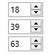
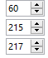
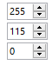
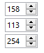
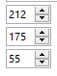
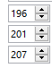
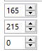
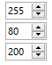
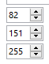
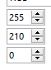
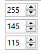
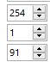
Colours
Primary colour
Dark Blue
Secondary colour
Aqua
Tertiary colours
Orange, Purple, Gold & Stone
+ Six additional colours for use on charts,
diagrams and infographics ONLY
+ Order of preference (starts with Aqua)
+ Red: semantic colour with limited use
Last four colours not in the palette, so will need to add values or use the eye dropper tool

